Slide 1
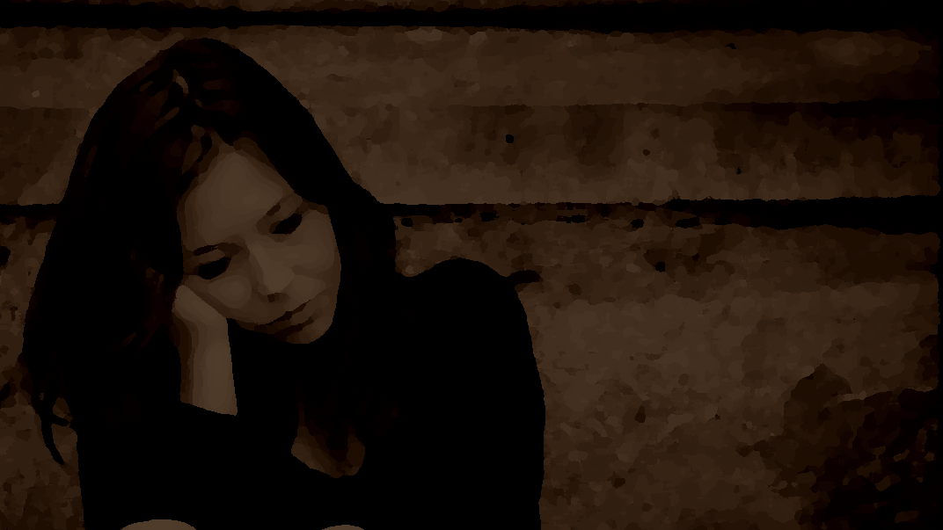
When
I
Sin
1 John 3:4
Notes:
No one on earth is immune to sin.
(Romans 3:23), “All have sinned and fall short of the glory of God”
The only person in the world who never sinned was Jesus.
(2 Corinthians 5:21), “For He made Him who knew no sin to be sin for us, that we might become the righteousness of God in Him.”
From the Bible we know that sin is the result of going against God’s law.
(1 John 3:4), “Whoever commits sin also commits lawlessness, and sin is lawlessness.”
Further, we know that those who remain in their sin will lose their souls!
(Matthew 7:23), “And then I will declare to them, ‘I never knew you; depart from Me, you who practice lawlessness!’”
Since we know that all sin, and that to remain in sin can lead to the condemnation of your soul, the question that each of us need to ask is, “What will I do when I sin?”
Following are some important insights in this area…

Slide 2
When I Sin
I am going to obey the gospel (Acts 2:38)
Notes:
I am not going to stay lost, I am going to obey the gospel and be baptized for the remission of my sins
(Acts 2:38), “Then Peter said to them, ‘Repent, and let every one of you be baptized in the name of Jesus Christ for the remission of sins; and you shall receive the gift of the Holy Spirit.’”
(Acts 22:16), “And now why are you waiting? Arise and be baptized, and wash away your sins, calling on the name of the Lord.”

Slide 3
When I Sin
I am going to obey the gospel (Acts 2:38)
I am going to repent (Genesis 3:8)
Notes:
I am not going to retreat; I am going to repent
(Genesis 3:8), “And they heard the sound of the Lord God walking in the garden in the cool of the day, and Adam and his wife hid themselves from the presence of the Lord God among the trees of the garden.”
(Luke 13:3), “I tell you, no; but unless you repent you will all likewise perish.”

Slide 4
When I Sin
I am going to obey the gospel (Acts 2:38)
I am going to repent (Genesis 3:8)
I am going to look up (Colossians 3:1-5)
Notes:
I am not going to give up; I am going to look up
(Colossians 3:1-5), “If then you were raised with Christ, seek those things which are above, where Christ is, sitting at the right hand of God. ² Set your mind on things above, not on things on the earth. ³ For you died, and your life is hidden with Christ in God. ⁴ When Christ who is our life appears, then you also will appear with Him in glory. ⁵ Therefore put to death your members which are on the earth: fornication, uncleanness, passion, evil desire, and covetousness, which is idolatry.”

Slide 5
When I Sin
I am going to confess it (Jas. 5:16)
I am going to obey the gospel (Acts 2:38)
I am going to repent (Genesis 3:8)
I am going to look up (Colossians 3:1-5)
Notes:
I am not going to hide it, I am going to confess it
(Proverbs 28:13), “He who covers his sins will not prosper, but whoever confesses and forsakes them will have mercy.”
(James 5:16), “Confess your trespasses to one another, and pray for one another, that you may be healed. The effective, fervent prayer of a righteous man avails much.”

Slide 6
When I Sin
I am going to confess it (Jas. 5:16)
I am going to ask for forgiveness (Acts 24:25)
I am going to obey the gospel (Acts 2:38)
I am going to repent (Genesis 3:8)
I am going to look up (Colossians 3:1-5)
Notes:
I am not going to ask for a more convenient season; I am going to ask for forgiveness
(Acts 24:25), “Now as he reasoned about righteousness, self-control, and the judgment to come, Felix was afraid and answered, “Go away for now; when I have a convenient time I will call for you.”
(1 John 1:9), “If we confess our sins, He is faithful and just to forgive us our sins and to cleanse us from all unrighteousness.”
(Luke 18:13-14), “And the tax collector, standing afar off, would not so much as raise his eyes to heaven, but beat his breast, saying, ‘God, be merciful to me a sinner!’ ¹⁴ I tell you, this man went down to his house justified rather than the other; for everyone who exalts himself will be humbled, and he who humbles himself will be exalted.”

Slide 7
When I Sin
I am going to confess it (Jas. 5:16)
I am going to ask for forgiveness (Acts 24:25)
I am going to love my Lord (John 6:66-69)
I am going to obey the gospel (Acts 2:38)
I am going to repent (Genesis 3:8)
I am going to look up (Colossians 3:1-5)
Notes:
I am not going to leave my Lord; I am going to love my Lord and Master
(John 6:66-69), [Jesus had just taught the necessity of eating His flesh and drinking His blood to gain eternal life. It was a teaching that disturbed many. “This is a hard saying; who can understand it?”], “From that time many of His disciples went back and walked with Him no more. ⁶⁷ Then Jesus said to the twelve, “Do you also want to go away?” ⁶⁸ But Simon Peter answered Him, “Lord, to whom shall we go? You have the words of eternal life. ⁶⁹ Also we have come to believe and know that You are the Christ, the Son of the living God.”

Slide 8
When I Sin
I am going to confess it (Jas. 5:16)
I am going to ask for forgiveness (Acts 24:25)
I am going to love my Lord (John 6:66-69)
I am going to stop sinning (1 Pet. 5:10)
I am going to obey the gospel (Acts 2:38)
I am going to repent (Genesis 3:8)
I am going to look up (Colossians 3:1-5)
Notes:
I am not going to be weaker; I am going to stop sinning and be stronger
(1 Peter 5:10), “But may the God of all grace, who called us to His eternal glory by Christ Jesus, after you have suffered a while, perfect, establish, strengthen, and settle you.”

Slide 9
When I Sin
I am going to live faithfully until I die (Revelation 2:10)
Notes:
I am not going to live fearful; I am going to live faithful all the way until my death
(Revelation 2:10), “Do not fear any of those things which you are about to suffer. Indeed, the devil is about to throw some of you into prison, that you may be tested, and you will have tribulation ten days. Be faithful until death, and I will give you the crown of life.”

Slide 10
When I Sin
I am going to live faithfully until I die (Revelation 2:10)
I am going to allow righteousness to reign (Romans 6:12-13)
Notes:
I am not going to allow unrighteousness to reign; I am going to allow righteousness to reign
(Romans 6:12-13), “Therefore do not let sin reign in your mortal body, that you should obey it in its lusts. ¹³ And do not present your members as instruments of unrighteousness to sin, but present yourselves to God as being alive from the dead, and your members as instruments of righteousness to God. ¹⁴ For sin shall not have dominion over you, for you are not under law but under grace.”

Slide 11
When I Sin
I am going to overcome sin (Romans 8:37)
I am going to live faithfully until I die (Revelation 2:10)
I am going to allow righteousness to reign (Romans 6:12-13)
Notes:
I am not going to be overcome by sin; I am going to overcome sin
(Romans 8:37-39), “Yet in all these things we are more than conquerors through Him who loved us. ³⁸ For I am persuaded that neither death nor life, nor angels nor principalities nor powers, nor things present nor things to come, ³⁹ nor height nor depth, nor any other created thing, shall be able to separate us from the love of God which is in Christ Jesus our Lord.”

Slide 12
When I Sin
I am going to overcome sin (Romans 8:37)
I am going to live for my Lord and Savior (James 4:7-10)
I am going to live faithfully until I die (Revelation 2:10)
I am going to allow righteousness to reign (Romans 6:12-13)
Notes:
I am not going to live for Satan; I am going to live for my Lord and Savior
(James 4:7-10), “Therefore submit to God. Resist the devil and he will flee from you. ⁸ Draw near to God and He will draw near to you. Cleanse your hands, you sinners; and purify your hearts, you double-minded. ⁹ Lament and mourn and weep! Let your laughter be turned to mourning and your joy to gloom. ¹⁰ Humble yourselves in the sight of the Lord, and He will lift you up.”

Slide 13
When I Sin
I am going to overcome sin (Romans 8:37)
I am going to live for my Lord and Savior (James 4:7-10)
I am going to live so as to go to heaven (Rev. 20:11-15)
I am going to live faithfully until I die (Revelation 2:10)
I am going to allow righteousness to reign (Romans 6:12-13)
Notes:
I am not going continue a life that will send me to hell; I am going to live so that I will go to heaven
(Revelation 20:11-15), “Then I saw a great white throne and Him who sat on it, from whose face the earth and the heaven fled away. And there was found no place for them. ¹² And I saw the dead, small and great, standing before God, and books were opened. And another book was opened, which is the Book of Life. And the dead were judged according to their works, by the things which were written in the books. ¹³ The sea gave up the dead who were in it, and Death and Hades delivered up the dead who were in them. And they were judged, each one according to his works. ¹⁴ Then Death and Hades were cast into the lake of fire. This is the second death. ¹⁵ And anyone not found written in the Book of Life was cast into the lake of fire.”
(Revelation 22:14-17), “Blessed are those who do His commandments, that they may have the right to the tree of life, and may enter through the gates into the city. ¹⁵ But outside are dogs and sorcerers and sexually immoral and murderers and idolaters, and whoever loves and practices a lie. ¹⁶ “I, Jesus, have sent My angel to testify to you these things in the churches. I am the Root and the Offspring of David, the Bright and Morning Star.” ¹⁷ And the Spirit and the bride say, “Come!” And let him who hears say, “Come!” And let him who thirsts come. Whoever desires, let him take the water of life freely.”

Slide 14
Conclusion
We need to stop our sin, and turn back to the Lord!
(Numbers 32:23)
Notes:
Conclusion
These steps that we have quickly covered are the perfect response to sin.
(Acts 3:19), [Peter’s words in Jerusalem], “Repent therefore and be converted, that your sins may be blotted out, so that times of refreshing may come from the presence of the Lord.”
You need to stop your sin and turn back to the Lord.
(Numbers 32:23), [Moses’ command to Israel to obey God, and do their duty as a people], “But if you do not do so, then take note, you have sinned against the Lord; and be sure your sin will find you out.”
Don’t reach the point where your sin is found out by man, or more importantly by God! — Stop it today!
Sermon based on an article by Kevin Maxey
http://www.bibleanswer.com/2018_Vol_20_No_41_05Aug.htm

